Slide 1




PROJECT-2 on Organization Management System
Presenting by:
Ajay Kumar Gadireddy
Varshith Reddy
Deepak D K
Yashashwini

Slide 2
PROBLEM STATEMENT
The basic idea of problem is to insert employee records, department details, project details into their respective files with EmployeeId,Department Id and Project Id as Primary key in their respective files.
In second case we have to get all employee details by using department name using StreamReader.
In third case we have to get all projects in the department by using department name using StreamReader.
In fourth case we have to get all projects of a Manager and the Manager Details using StreamReader.

Slide 3
APPROACH
The main logic behind the problem is to search all employee details by taking department name if it is found it will display all employees who had worked under particular department using StreamReader and if it is not found will display department id not found in the file,
In this problem we searched deptname by partitioning line into substrings and matching required characters using PadLeft method of substrings.
By using same technique further problems are resolved.

Slide 4
Functionalities
Insert Employee/Department/Projects
Search Employees By Department Name
Search Projects By Department Name
Search Project by the Manager Id and to give the details of the Employee
Display Employee/Department/Projects details.

Slide 5
Abstract Of Classes
Employee Department
Project
Attributes
EmpId➔PK
EmpName
Phone
Email
DeptId
Attributes
DeptId➔PK
DeptName
Num Of Projects
Attributes
PrjctId➔PK
PrjctName
DeptName
MgrId

Slide 6
Method Functionality
Search by[fileused,file1,file2]:
By using the padleft and substrings method of strings we can find a particular search key is present in file or not[basically a foreign key]. By this we can retrieve the details from the another file and display them.

Slide 7
SOURCE CODE
https://github.com/ajaykumargadireddy/DotnetProjects.git

Slide 8
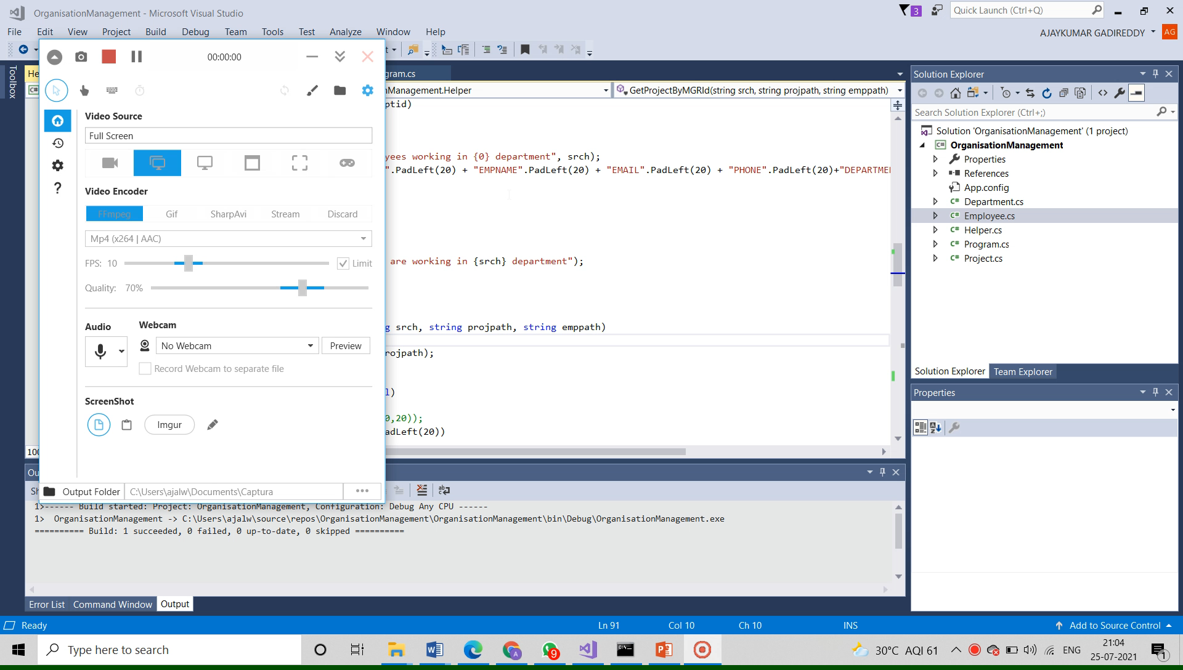
EXECUTION

Slide 9
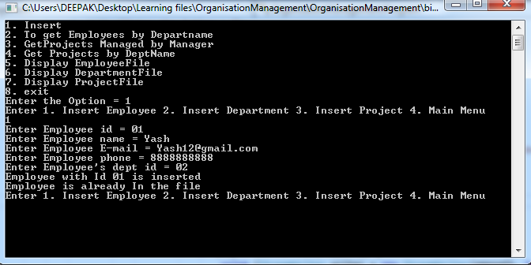
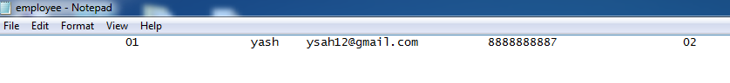
RESULT

Slide 10
Thank you

